Slide 1

SE577:Software Architecture
Week 1: Course Overview
Dr. Brian Mitchell CCI
Drexel University

Slide 2
About the Instructor
Dr. Brian Mitchell
Professor in Computer Science
Background
B.S., M.S., and Ph.D. in Computer Science
M.E. in Computer and Telecommunication Engineering
Involved with CS Department Teaching, Research and Industry collaboration since 1997
Ph.D. work in Software Architecture Recovery
Contact Information
Email: bsm23@Drexel.edu
Office Hours: by appointment, standing office hours posted on Blackboard
Webpage: https://www.cs.drexel.edu/~bmitchell/

Slide 3
Teaching Assistant Information
See Blackboard
Office Hours: TBD

Slide 4
About this course
Objectives
Teach students about the knowledge, duty, and skills needed by software architects
Teach students the essential skills of software architecture modeling and analysis
Teach students architecture patterns and styles
Teach students how to specify and analyze quality attributes
Teach students how to analyze architecture embodied in open source projects.
Teach students advanced topics in architectural design.

Slide 5
About this course
Learning outcomes: students completing this course should be able to:
Apply architectural principles and skills to create software systems
Model software architecture and analyze various trade-offs.
Apply architectural patterns to solve real problems
Identify architectural styles in open source projects
Analyze software requirements and choose proper architecture styles.
Reason about architecture quality attributes.

Slide 6
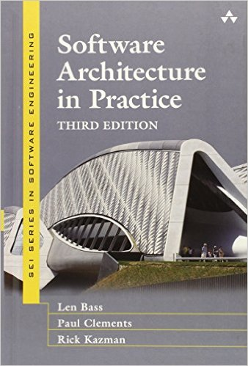
Learning Material
Reference Book 1:
“Software Architecture in Practice”
4th Edition, by Len Bass, Paul Clements, Rick Kazman

Slide 7
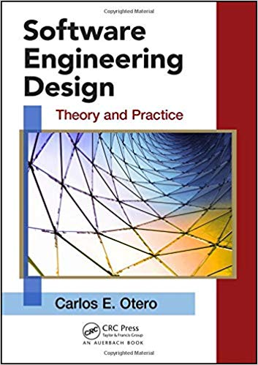
Learning Material
Reference Book 2:
“Software Engineering Design: Theory and Practice”
First Edition, by Carlos Otero

Slide 8
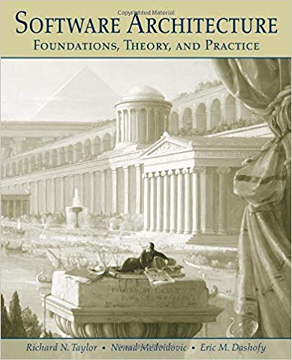
Learning Material
Reference Book 3:
“Software Architecture: Foundations, Theory, and Practice”
First Edition, by R. N. Taylor, N. Medvidovic, E. M. Dashofy

Slide 9
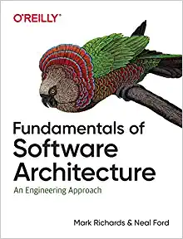
Learning Material
Reference Book 4:
“Fundamentals of Software Architecture”
by Mark Richards, Neil Ford

Slide 10
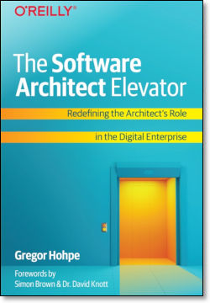
Learning Material
Reference Book 5:
“The Software Architect Elevator”
by Gregor Hohpe
45 Minute Podcast Summary
https://podcasts.google.com/feed/aHR0cHM6Ly90aG91Z2h0d29ya3MubGlic3luLmNvbS9yc3M/episode/YzYzNjA2ZjYtYzVkZC00YTRmLTg2NDItNTU3YzExOWIzZWRm?hl=en&ved=2ahUKEwisvZnZ8u72AhULZd8KHXNQDpwQjrkEegQIAhAF&ep=6

Slide 11
Assignments, Assessments, and Evaluations
Individual assignment with multiple deliverables:
Design, analyze, and implement software architecture
Apply architecture patterns to achieve extensibility
Reason about various architecture quality attributes
Reading assignments, 2 foundational and 2 modern software architecture papers

Slide 12
Assignments, Assessments, and Evaluations
Grading Component:
Course Reading summaries and other assignments 40%
Course Project 50%
Participation: 10%

Slide 13
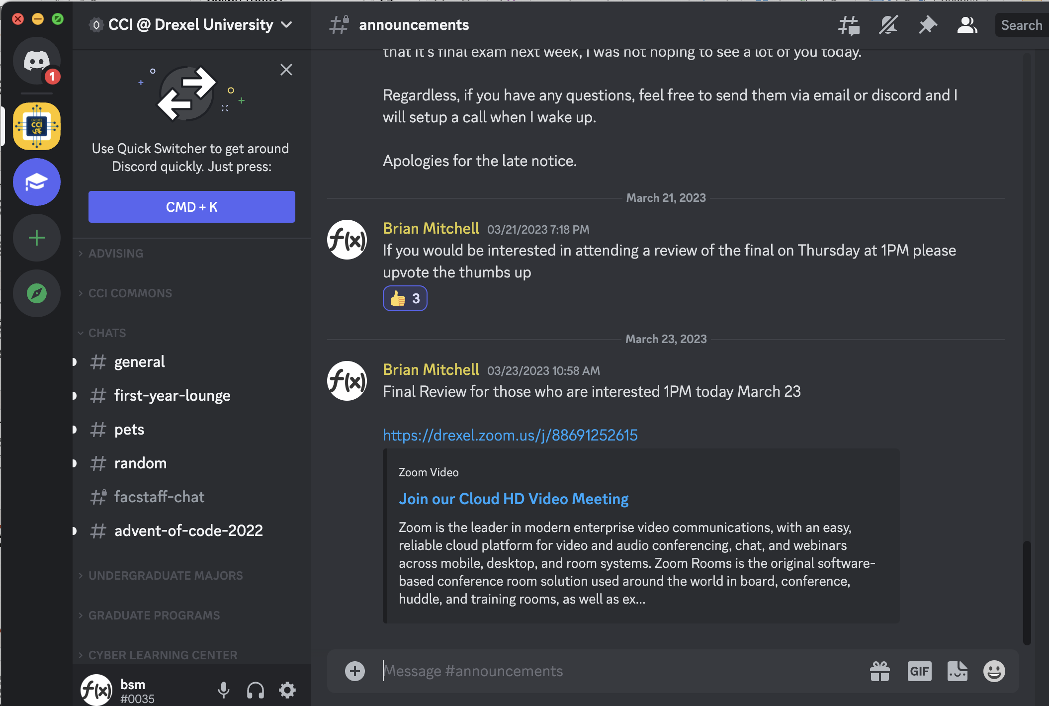
Discord will be our PRIMARY mode of communication
Please make sure you have it on your computer/phone

Slide 14
This course will focus on the technical and non-technical aspects of being a software architect
The titling and labeling in industry of software engineering roles is problematic…
Software Architecture Focus
Pure Software Developers
Pure Software Architects
Software Development Focus
Most modern software engineers will have a blend of software development and software engineering skills
Picking the right blend matters however

Slide 15
This course will focus on the technical and non-technical aspects of being a software architect
Software Architecture Focus
Software Development Focus
“All I Care About is the Tech” Zone
I focus on the technical architecture decisions and tradeoffs
“I am the master of nothing” zone – “Wikipedia Architecture”
I focus on the strategic product architecture decisions and tradeoffs
“Let's deploy this latest architecture I read about” zone

Slide 16
A word about the technologies we will be using
We will be using modern technologies to demonstrate modern software architecture toolchains and implementation patterns
I will allow students to program in Java, but I will not be using Java in this class
My views about why its time to move away from Java for modern software engineering
LETS USE THIS AS AN EXAMPLE DEMONSTRATING WHAT AN ARCHITECT DOES AND WHAT YOU SHOULD BE ABLE TO DO AFTER TAKING THIS CLASS

Slide 17
Our first software architecture example
Architecture Guidance: For most new modern development the overall JVM ecosystem should be avoided, if the criteria for acceptable use of the JVM ecosystem are met, then:
Existing Java code bases can continue to be developed and extended in Java – significant new development or enhancements to these systems should consider moving over to Kotlin.
Java Virtual Machine
JVM Runtime
JVM Ecosystem Architecture
JVM Ecosystem
JVM Languages
JAVA
Kotlin
Lets examine this from an architects viewpoint – We will learn later that this can be articulated as an architecture decision record (ADR)

Slide 18
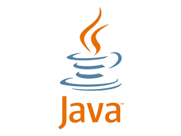
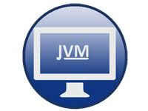
First Architecture Example: Lets analyze the Java
Java first appeared in 1995
Objective: Improve on scale, simplicity, portability over things like C/C++
Obsessive focus on Backwards Compatibility
Implementing “best of class” support for object orientation
The Java Virtual Machine is one of the most impressive pieces of software ever developed
Provides an isolated sandbox for running applications
Provides a portable runtime for multiple architectures
Over the years has achieved near native performance
ON THE SURFACE PRETTY AWESOME – WHAT DO YOU THINK?

Slide 19
First Architecture Example: Lets analyze the Java - II
We will be learning that architecture is largely about tradeoffs
Feature | Implication
Backwards Compatibility | GREAT: Code written today or 20 years ago largely compiles as is GREAT: JVM enhancements over the years enables Java to run at speeds comparable with any modern programming language ISSUE: Early Java language decisions based on the state of software engineering and object orientation in the 1990s have been shown to be suboptimal – but we are still stuck with them. Implications – Type erasure at compile time for generics, improper lambdas/closure support, awkward functional programing extensions, inconsistent views of object vs native types
Language Syntax | Great 30 years ago when compared to other languages at the time But lacking many of the things that have proven to be useful in modern programming languages: awkward type inference, immutability not a first-class concern, extremely verbose
Developer familiarity | When Java rolled out, standardizing around a language made a lot of sense. Although Java has been “free” since the get go, a large ecosystem of expensive commercial tools were centered around Java-based systems – the infamous Java Application Server – if you are investing millions on a Java based commercial runtime, you need Java developers/engineers
Portability | In the early days you wanted to develop on one OS but deploy to another OS – Java had excellent support for this, but this is no longer a “big deal”

Slide 20
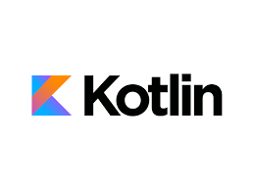
Arguing Recommendation 1: Major refactoring of Java apps should move to Kotlin
Kotlin is significantly less verbose than java
Less code = less bugs
Less code = more productivity
Kotlin embraces modern language features
Better support for distributed systems, which are most systems these days
Kotlin is interoperable and easy to learn
Simple to start integrating kotlin into existing projects as well as starting new projects with kotlin
Kotlin is popular
Kotlin’s killer use case was Android development, but has now expanded as a popular choice with traditional Java developers

Slide 21
Arguing Recommendation 2 Avoid the JVM for largely Net New efforts, Part 1
Java Virtual Machine
JVM Benefits
Provides isolated environment for executing your code
Provides runtime management for your executing code
Provides multi-threaded, and multi-process abstractions on top of OS
Portable across Operating systems
JVM Runtime
JVM Ecosystem
JVM Workloads
Your Code is Here
JVM Limitations
Cold start times because the JVM adaptively optimizes
Only supports JVM-based languages – Java, Kotlin, etc
Overall JVM Architecture

Slide 22

Arguing Recommendation 2 Avoid the JVM for largely Net New efforts, Part 2
Docker Benefits
Provides isolated environment for executing your code
Provides runtime management for your executing code
Provides multi-threaded, and multi-process abstractions on top of OS
Portable across Operating systems
Language, framework agnostic
Can be composed with other containers
Light footprint – e.g, Alpine Linux base image is 5Mb.
Has all of the benefits of the JVM and then some
Docker Engine
Docker Image
Virtual OS
Your Code Dependencies
Your Code is Here
Unrelated – some are speculating that server-side webassembly will be the “next thing” to take over from docker
Overall Docker Architecture

Slide 23
Arguing Recommendation 2 Avoid the JVM for largely Net New efforts, Part 3
Docker Engine
Docker Image
Virtual OS
Thoughts on Embedding the JVM in a Docker Container?
JVM
Docker OK
JVM Runtime
JVM Ecosystem
JVM Workloads
Your Code is Here
JVM OK

Slide 24
First Architecture Example: Lets analyze the Java - II
Lets look at a “Layered” Architecture that’s popular these days for web services
Java Virtual Machine
Docker Engine
Pretty typical memory footprint is 1G minimum, most is needed for the JVM vs your code
Java Based Web Server Netty/Tomcat
Docker Image
Pretty typical memory footprint is 30-50Mb
Virtual OS
Spring Boot
API Library (ex, golang-gin)
Your Code
Your config
Spring MVC
Your Code
Your Configuration
Not a big deal if you have relatively few services, but most organizations these days have thousands of services. Plus in the cloud you pay for memory

Slide 25
Architecture Rationale, Guidance Recommendations I
Javas key strength is backwards compatibility, but its design is old and results in code-bloat that can largely be mitigated with newer JVM languages like Kotlin
Kotlin drives higher productivity and less errors (write less boilerplate), but also embraces modern language features that lend themselves to better support of modern distributed applications
Since Kotlin interoperates well with existing Java codebases, significant enhancements of existing Java codebases should consider Kotlin
New JVM development should STRONGLY consider Kotlin

Slide 26
Architecture Rationale, Guidance Recommendations II
For more modern workloads, containerizing in docker is a better choice than running in the JVM, especially for cloud native architectures, or public cloud deployments
While containerizing JVM based architectures is possible, it should be avoided due to the heavy JVM footprint coupled by all of the JVM benefits being mitigated by docker
Additionally, the memory and compute footprint of Dockerized JVM solutions is large, and these resources cost money, especially in the public cloud
Recommendation for new development - Leverage a modern programming framework such as go or typescript, which deploy naturally to both dockerized and serverless runtimes.

